Slide 1
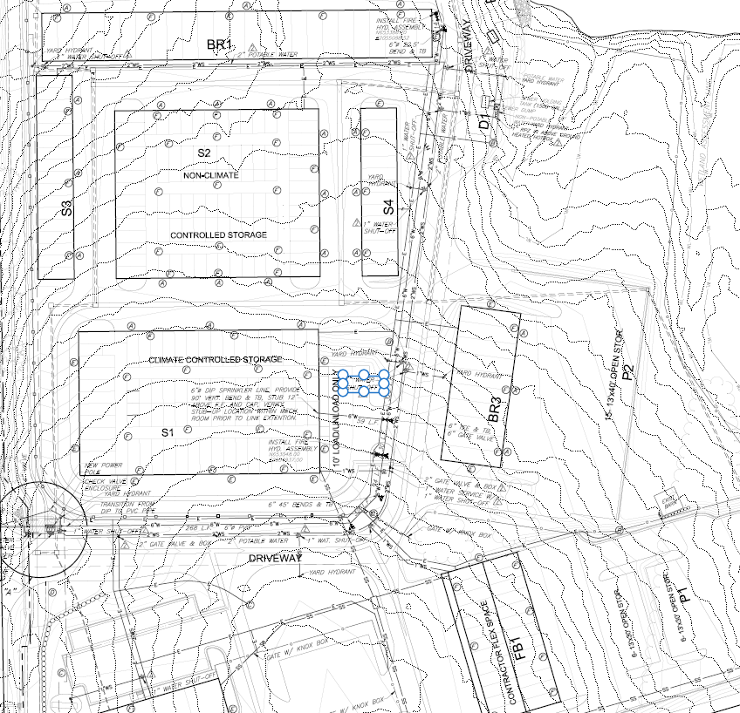
5
4
3
2
1
Internet Switch
7
6
5
4
8
7
3
6
5
2
4
3
Internet Switch
2
1
1
Internet Switch
1
2
3
X
Internet Switch
Internet Hub
1
Internet Switch

Slide 2
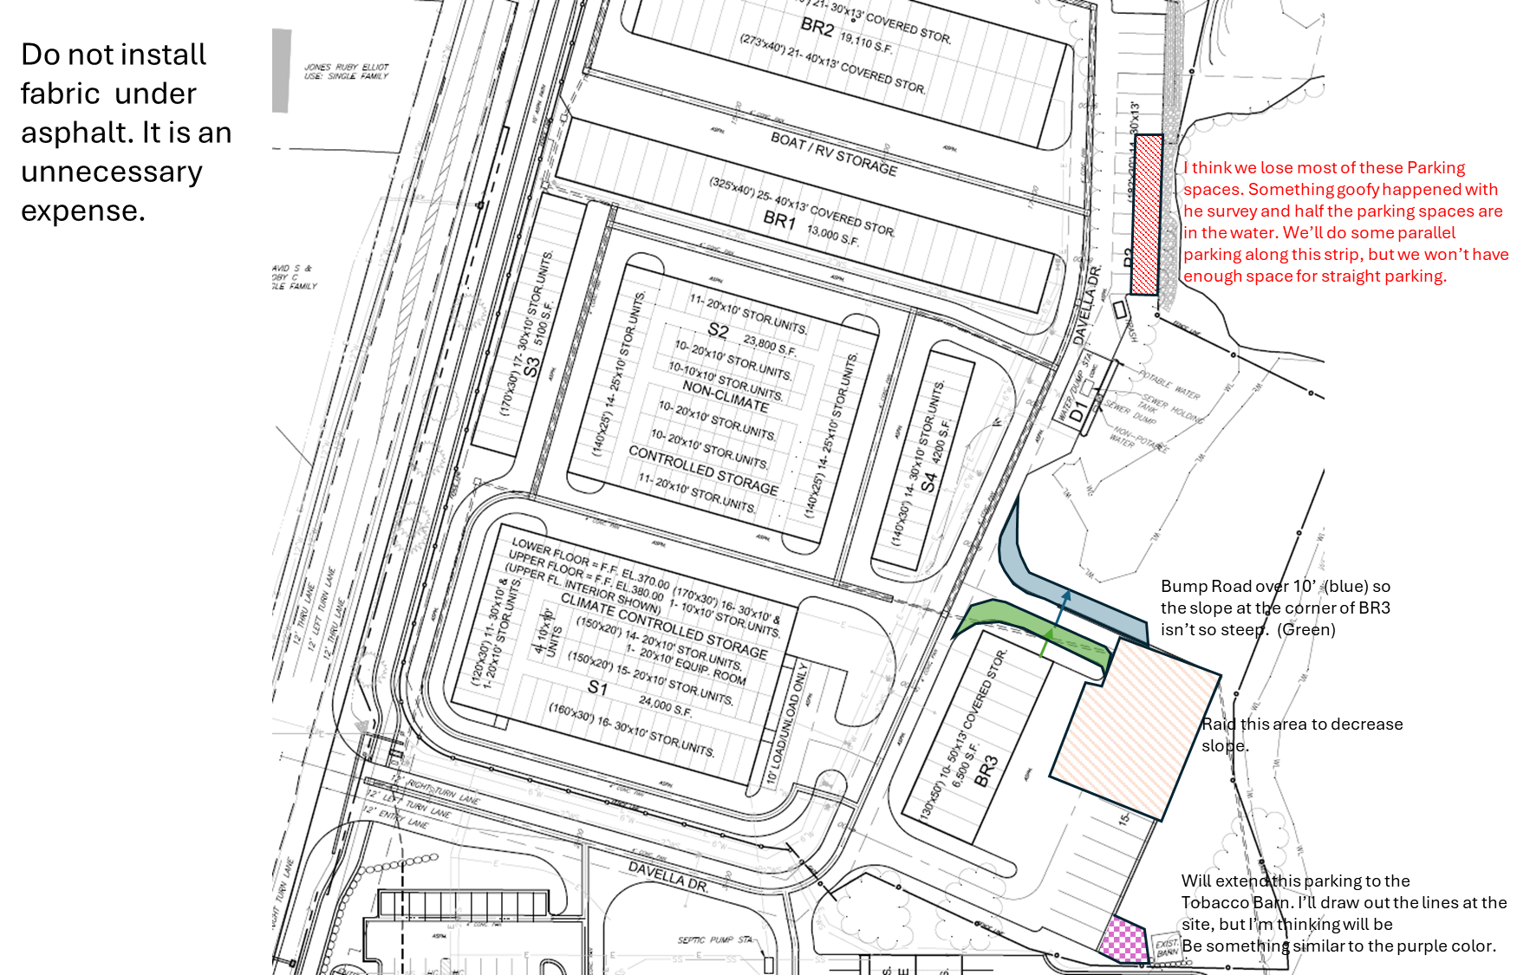
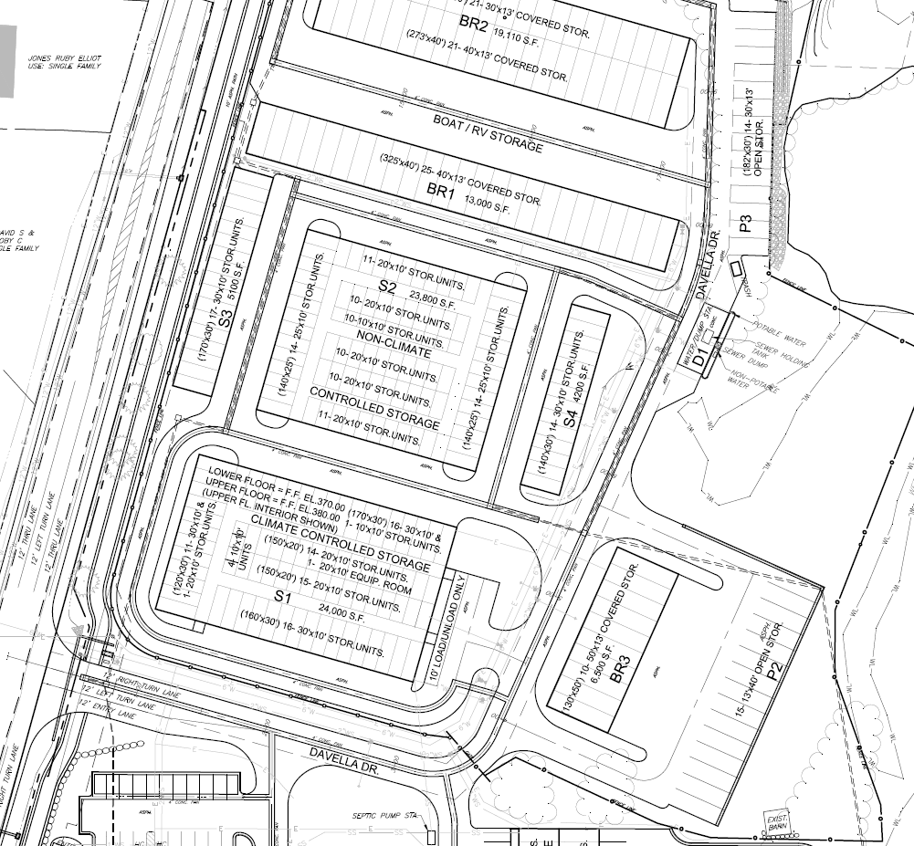
Do not install fabric under asphalt. It is an unnecessary expense.
I think we lose most of these Parking spaces. Something goofy happened with he survey and half the parking spaces are in the water. We’ll do some parallel parking along this strip, but we won’t have enough space for straight parking.
Bump Road over 10’ (blue) so the slope at the corner of BR3 isn’t so steep. (Green)
Raid this area to decrease slope.
Will extend this parking to the
Tobacco Barn. I’ll draw out the lines at the site, but I’m thinking will be
Be something similar to the purple color.

Slide 3
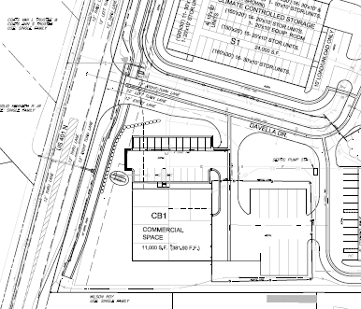
= Southern Magnolia
= Lop Lolly Pine
= Patch of Fermosa Azaleas and natural shrubs like a Gold Dust Acuba. May need to spot place based on road visibility of sign. Don’t want the trees and shrubs to block sign.

