Slide 1
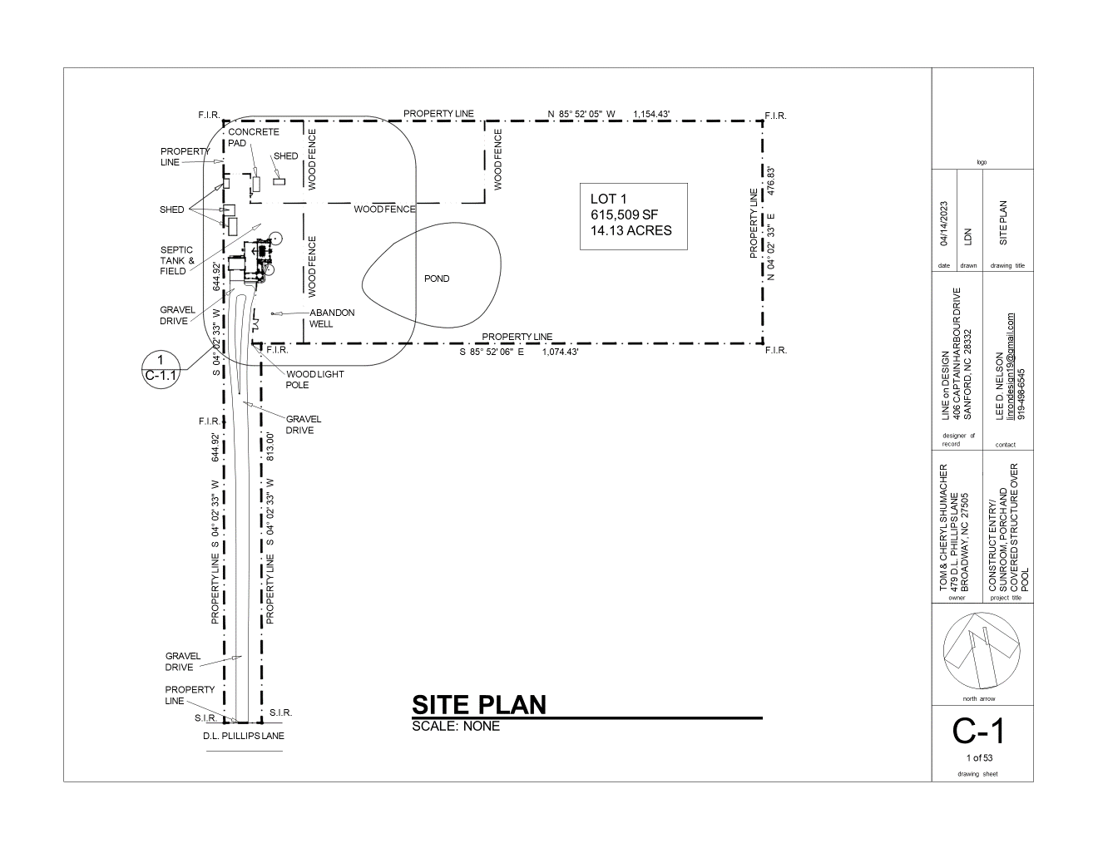
Building Setbacks
Front 35’
Rear 20’
Side Corner 20’
Max Height 35’
270’
25’ Rear Setback
10’ Side Setback
10’ Side Setback
970’
45’
3 bay garage under permit # BRES2404-0009
118’
Pond
35’ Front Setback

