Slide 1
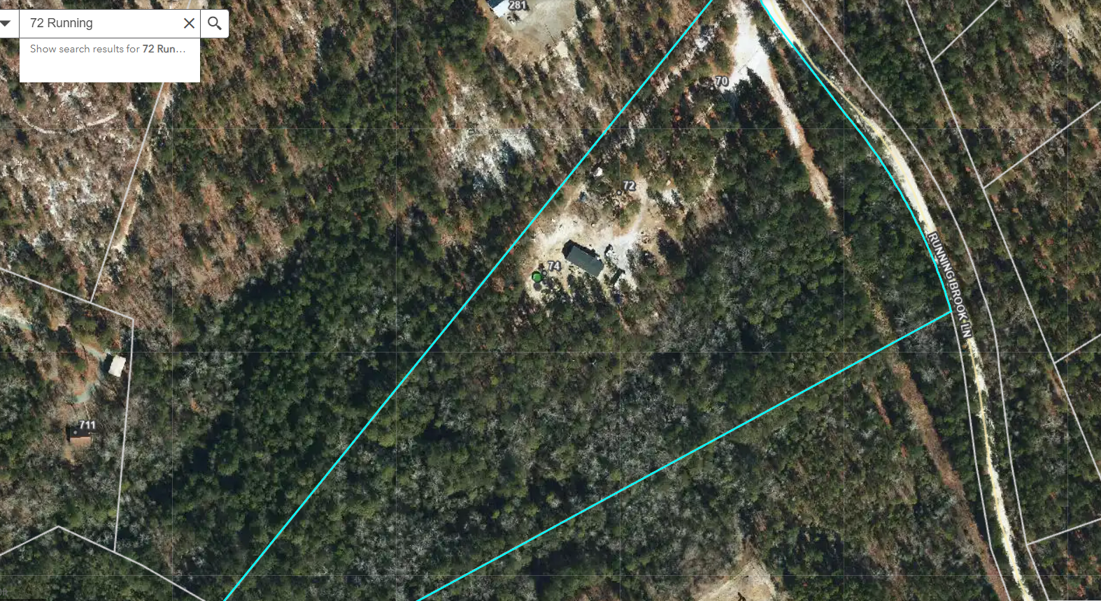
72 RunningBrook 30’x40’ Shed Macro/ Setbacks
Corner Setback 415’
Front Setback 410’
Side Setback 35’
Back Setback 1,040’

Slide 2
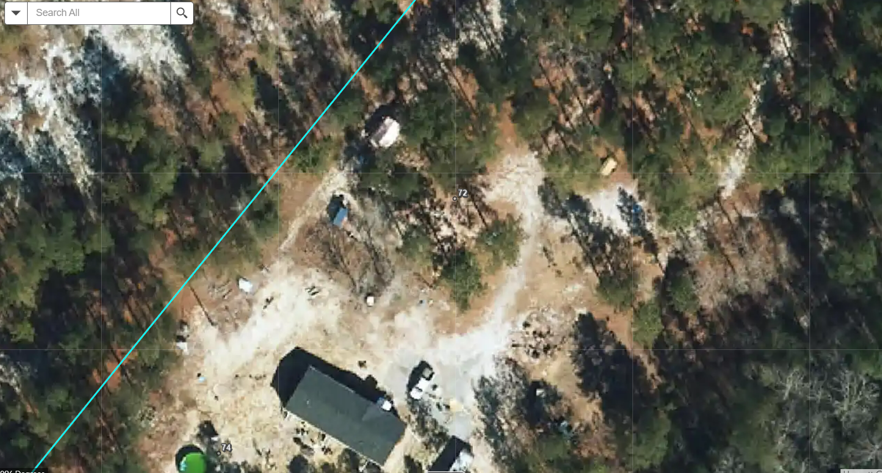
72 RunningBrook LN 30’x40’ Shed Micro
Would like to build 30’x40’ Steel storage shed. Currently have one 4 bedroom manufactured home located on the property. Shed would be set 35’ off Side/Western property line, 410’ off Front/Northern property line, and 1,040’ off of Back/Southern property line. Will be placing on concrete pad, planned vendor/contractor is Sheds Plus.

