Slide 1
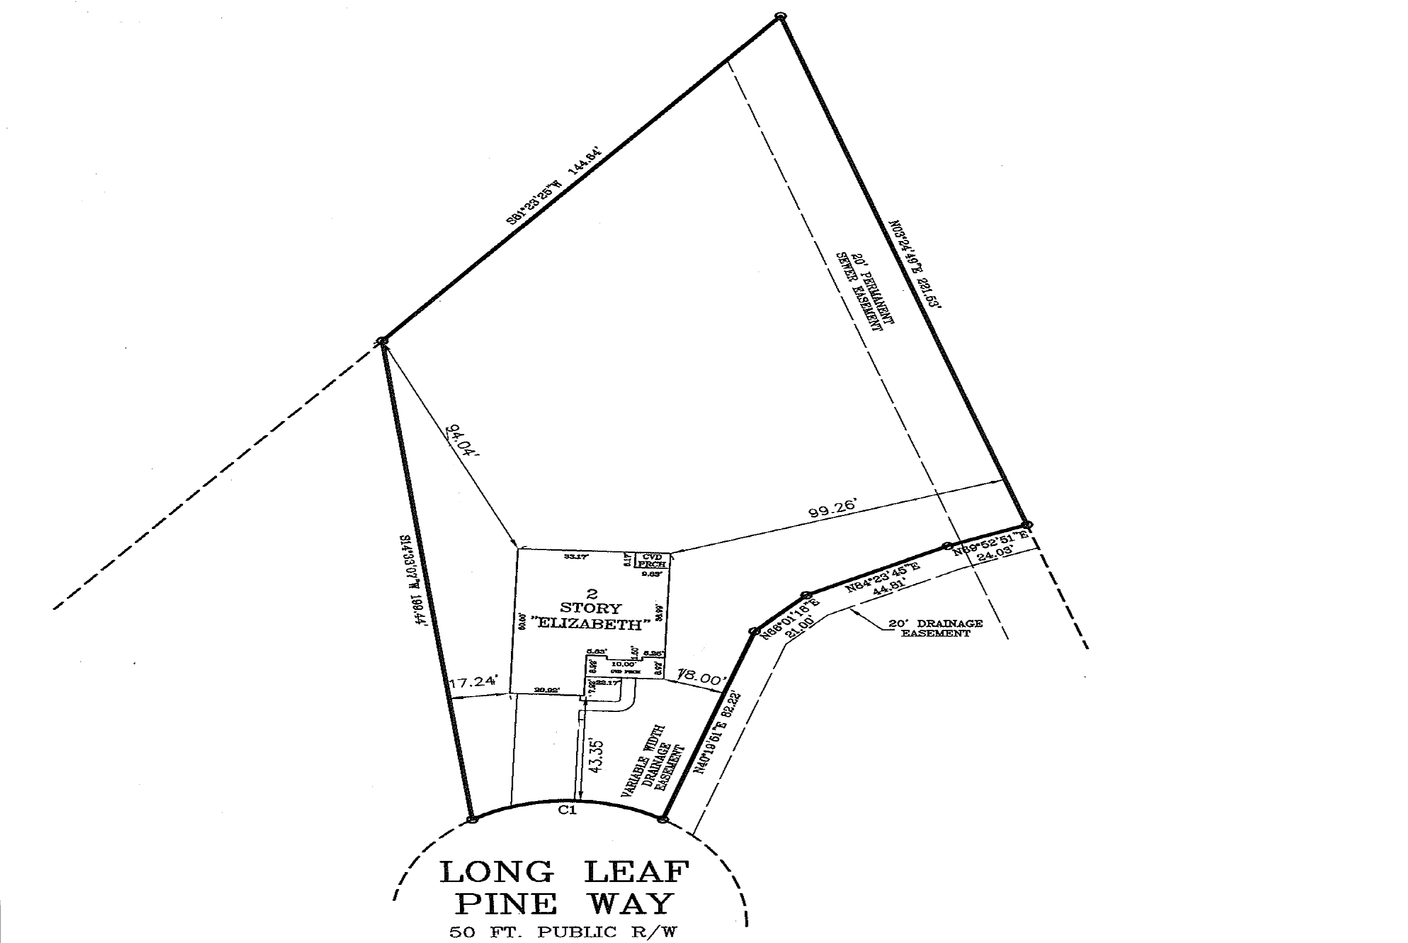
Robertson, Richard 145 Longleaf Pine Way, Sanford, NC 27332
26’
12x24
Pre built wood shed
53’

