Slide 1
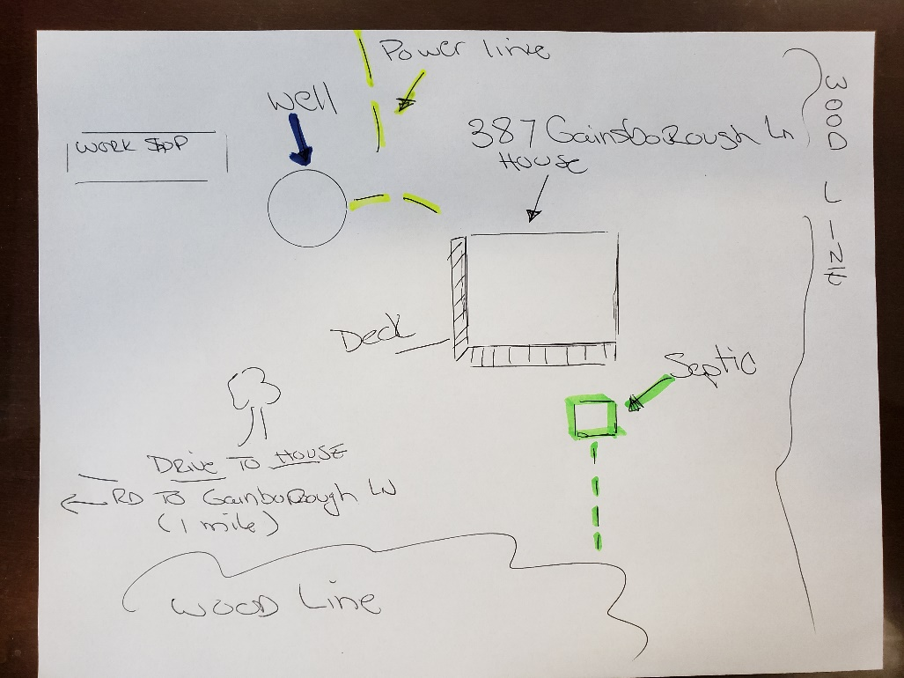
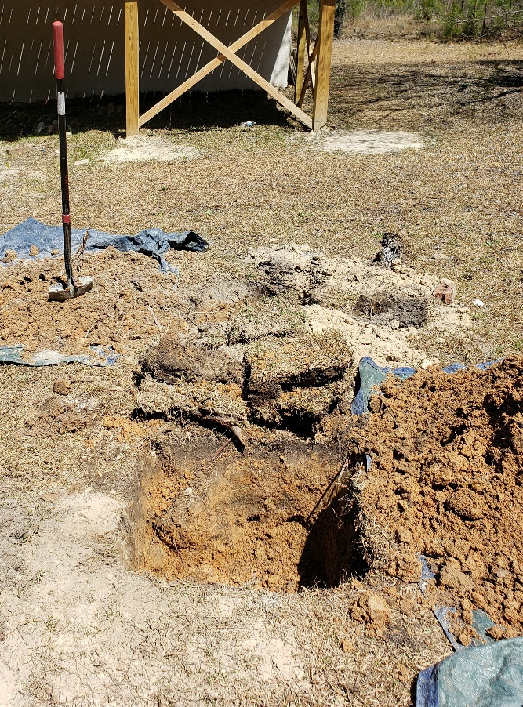
Site Diagram: 387 Gainsborough Ln, Cameron NC
Septic: Marked, Dug, and Inspected
by Marlin Wastewater Service 05 APR 2021
(Lids remain popped)

