Slide 1
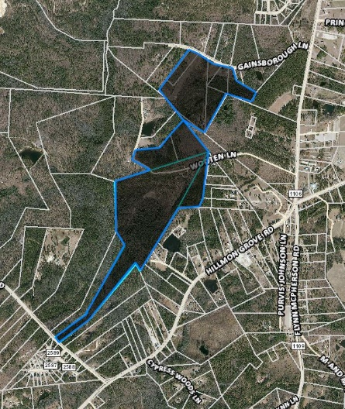
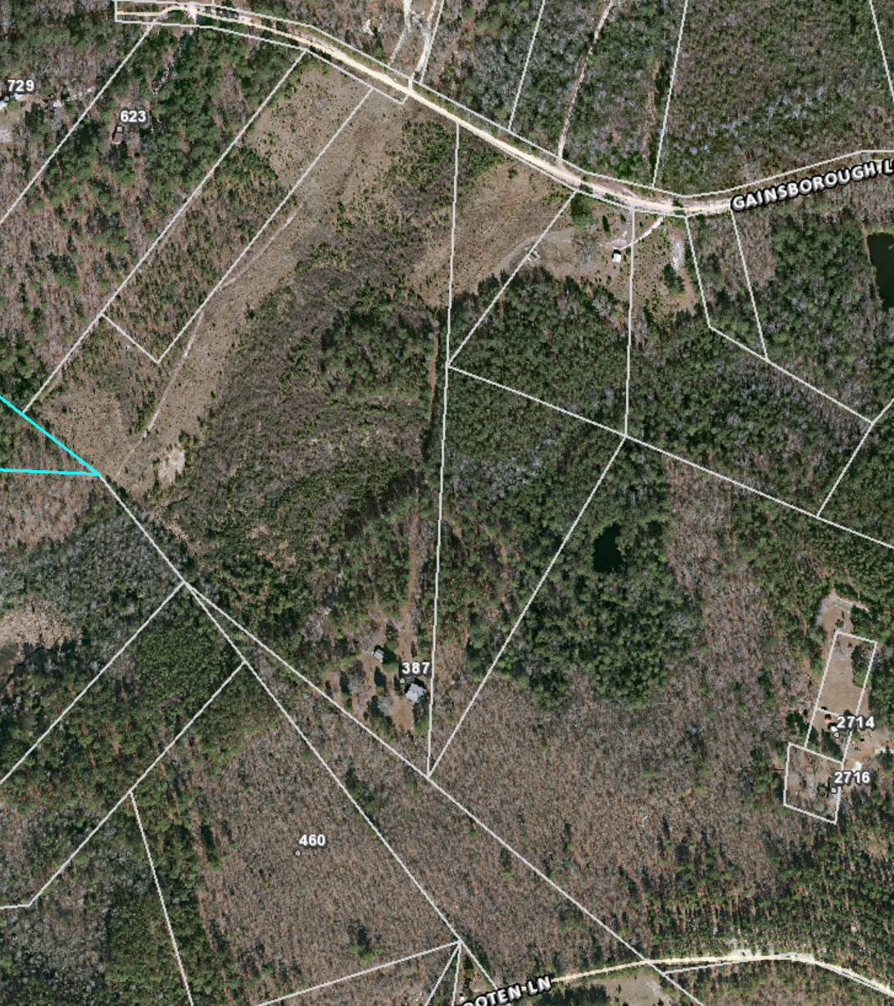
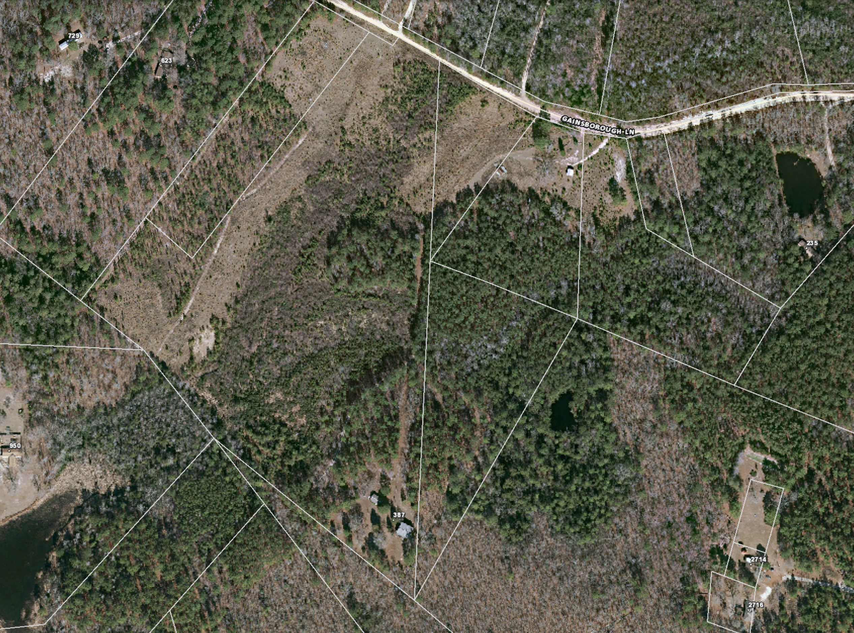
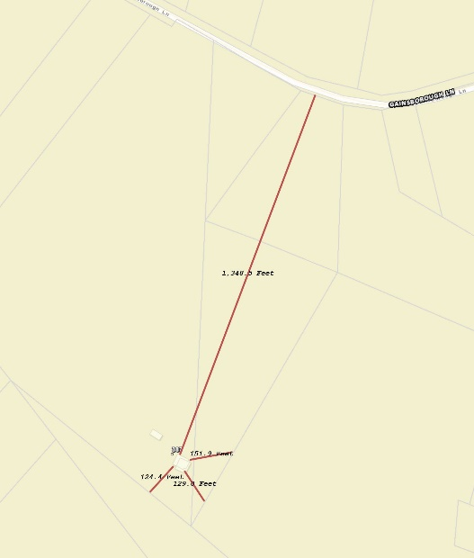
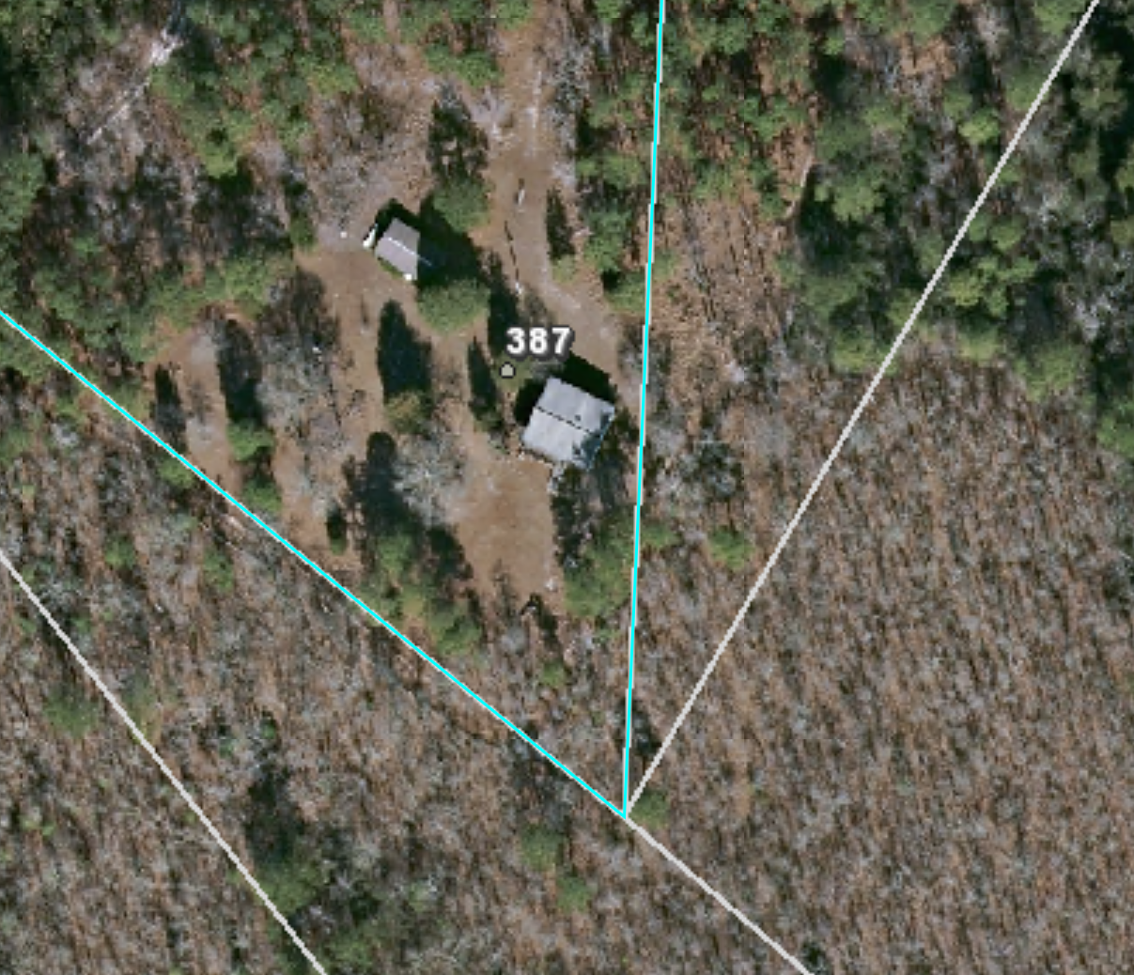
All Photos From Harnett GIS 06 APR 2021
Fancher’s Property (148 Acres)
Blow Up 1 of Farm House (387 Gainsborough Lane)
Blow Up 2 of Farm House (387 Gainsborough Lane)
Legend
Well (Over 100ft from Septic)
Septic (Over 5 from Construction Site /Deck)
Property Line (Corners of House to Property Line)
Front Left Distance: 124 ft
Front Right Distance: 1,385 Ft
Rear Left: 130 Ft
Rear Right: 152 Ft
Blow Up 3 of Farm House w/ Property Lines
Well and Septic
GIS Site Map w/ Property Lines Using GIS
Measuring Tool

