Slide 1
School Plan:
-Location: Rawls Baptist Church
10665 US-401
Fuquay-Varina, NC 27526
-Ages: 5-11 (no Pre-k)
-Students: 10-15
-Teachers: 2-3
-Hours: 8:00 am – 2:30 pm
-Days: Mon-Fri
-Food served: NO
-Classrooms: 2-3. Grades K-2 will be located on ground floor. Grade 3-5 will utilize classroom on second floor.
-Emergency Exit Plan: Teachers and Students will exit building and assemble in parking lot to north of the building.
Legend:
Emergency lights
E
Exit
Fire Extinguisher
Pri. Emergency Exit Route
Alt. Emergency Exit Route
Bathroom
Room being utilized

Slide 2
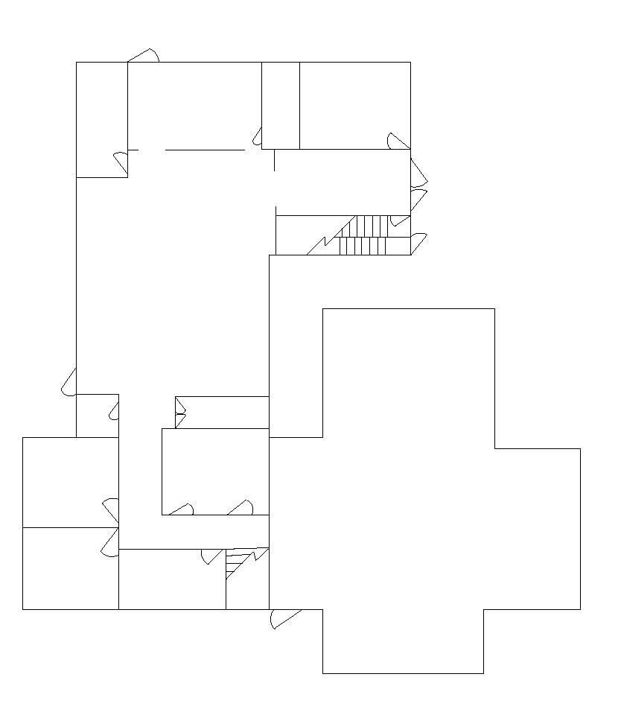
First Floor
E
Emergency Assembly Area
Kitchen
Office
E
Parking
RTE 401
Classroom 1
Sanctuary
E
E
E

Slide 3
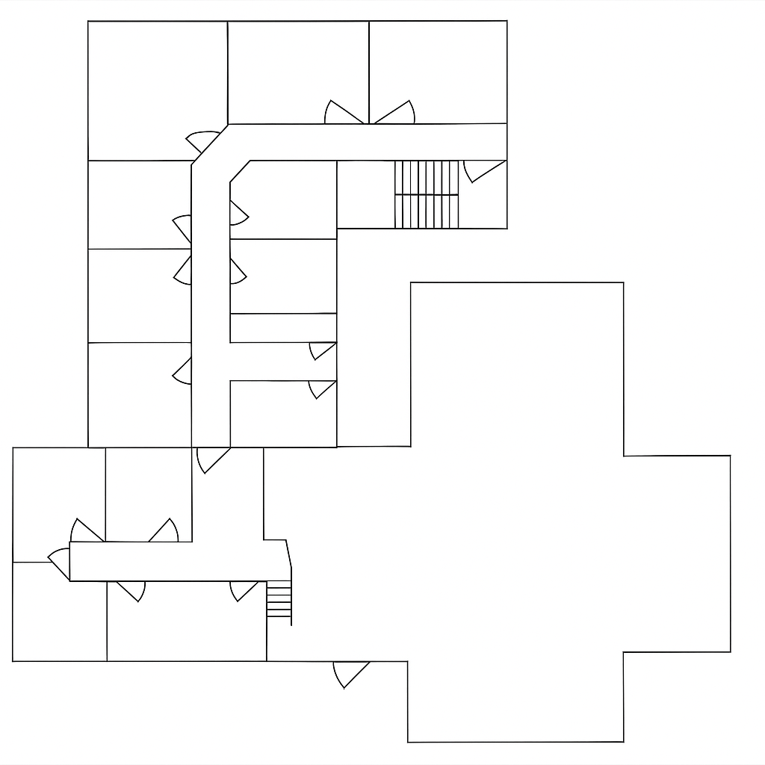
Second Floor
Emergency Assembly Area
Spare Room
Classroom 2
Parking
RTE 401
Sanctuary
E
E

