Slide 1
Johnsonville Elementary 1 of 2
June 12, 2023

Slide 2
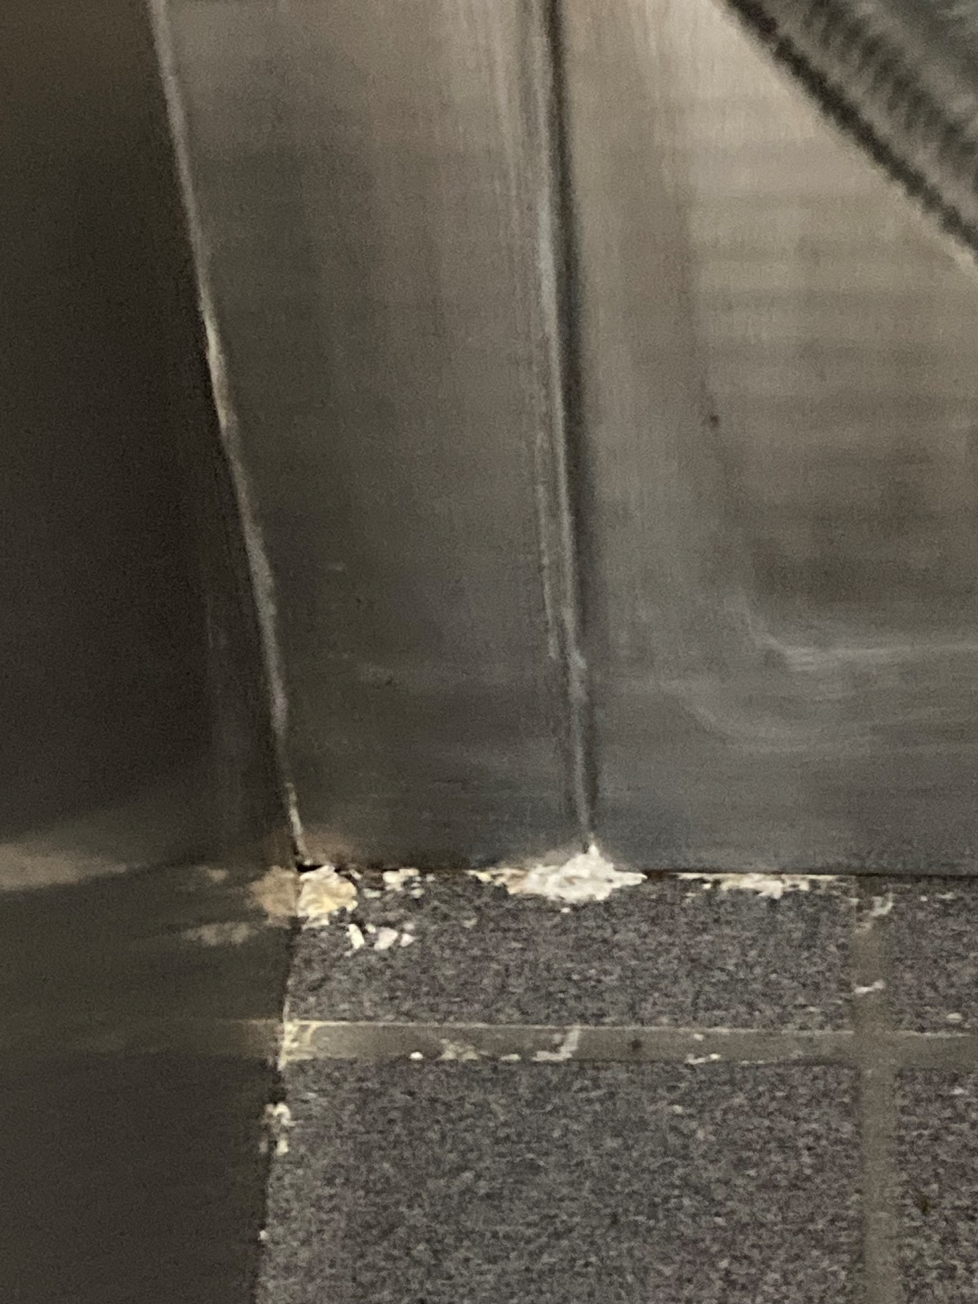
Half wall
behind
cooking
equipment.

Slide 3
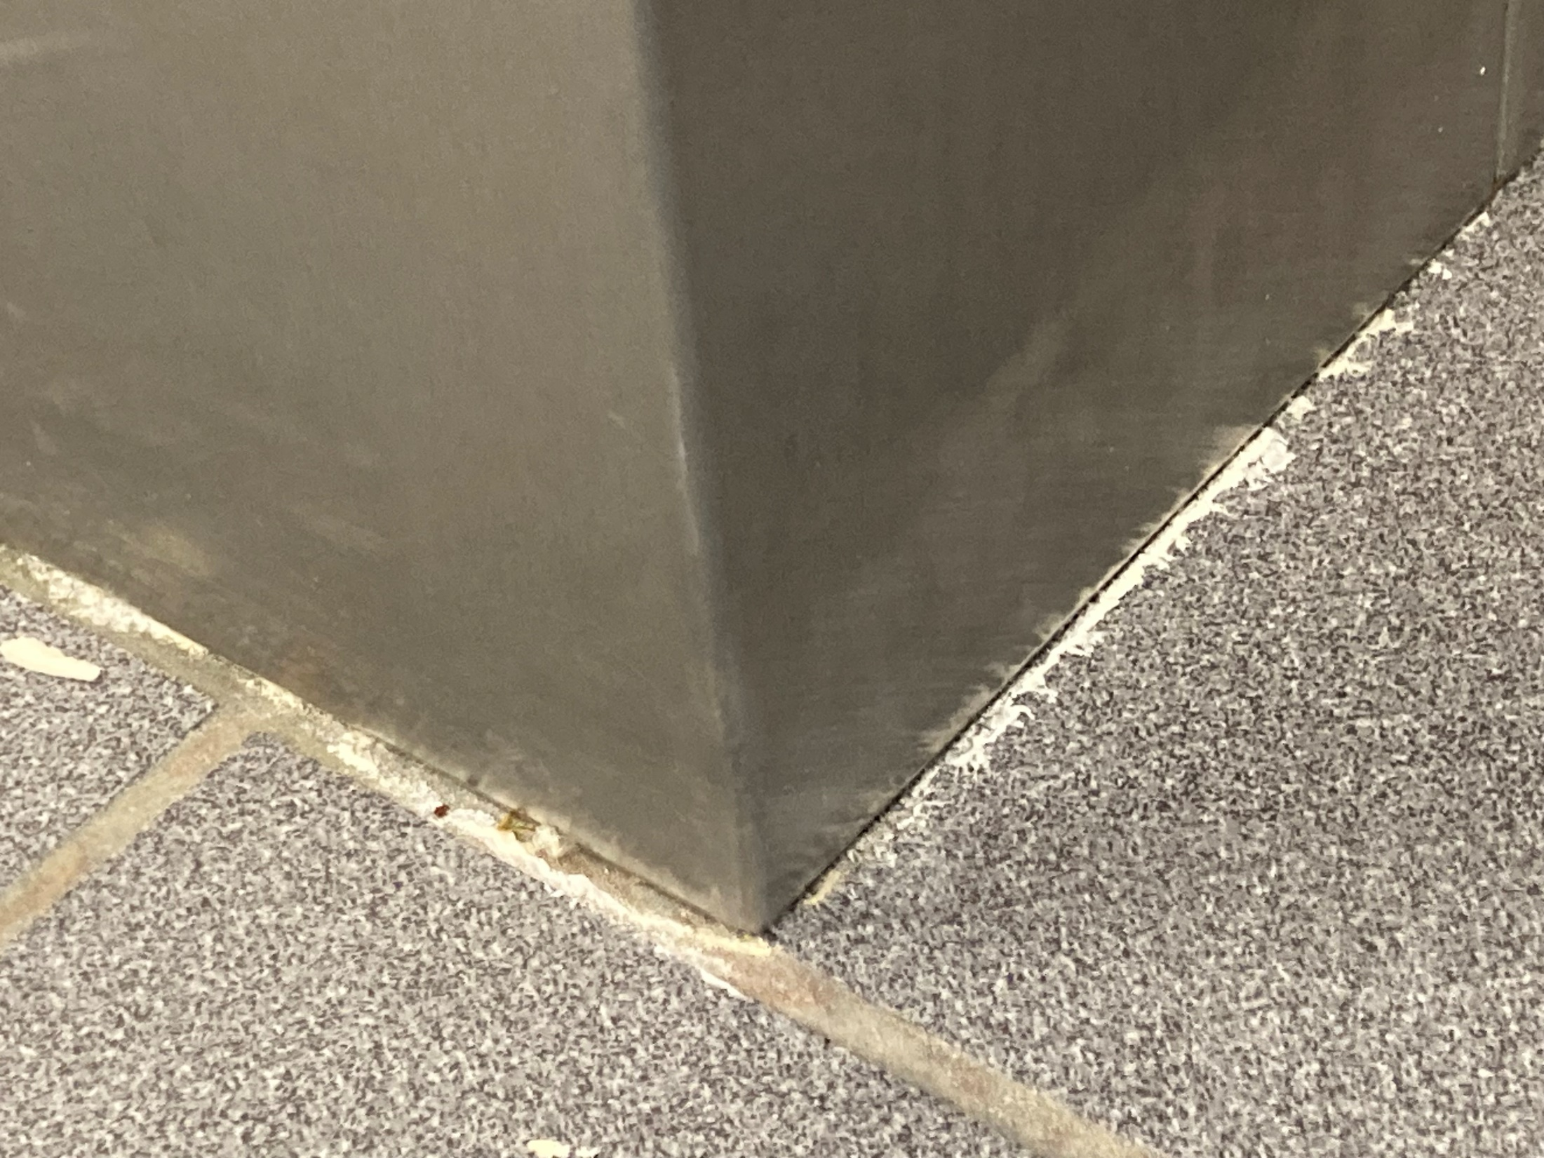

Slide 4
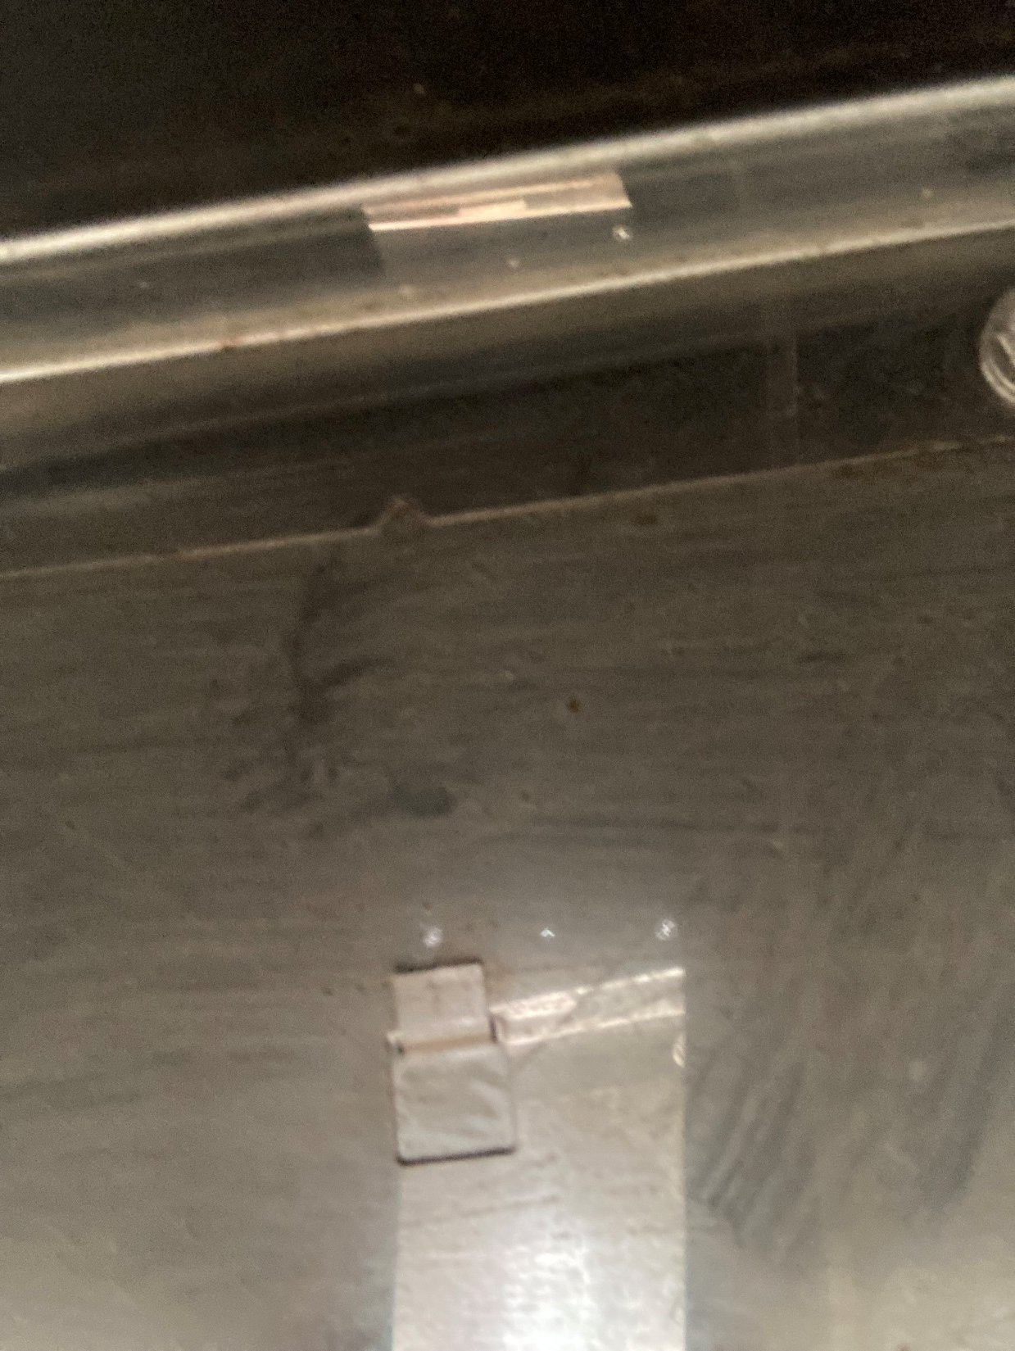
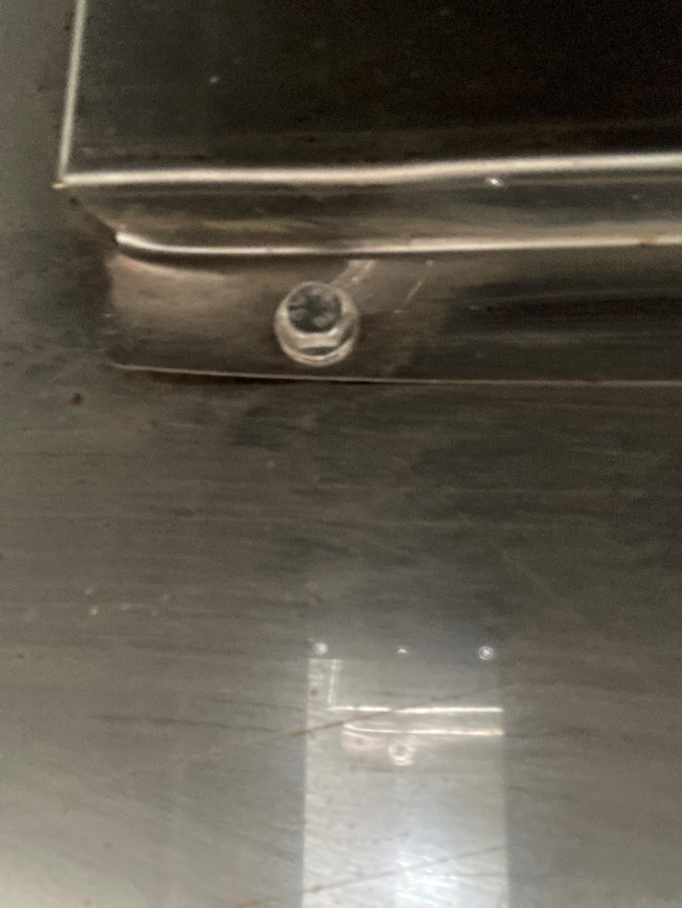
The underside of a piece of equipment under the hood.

Slide 5
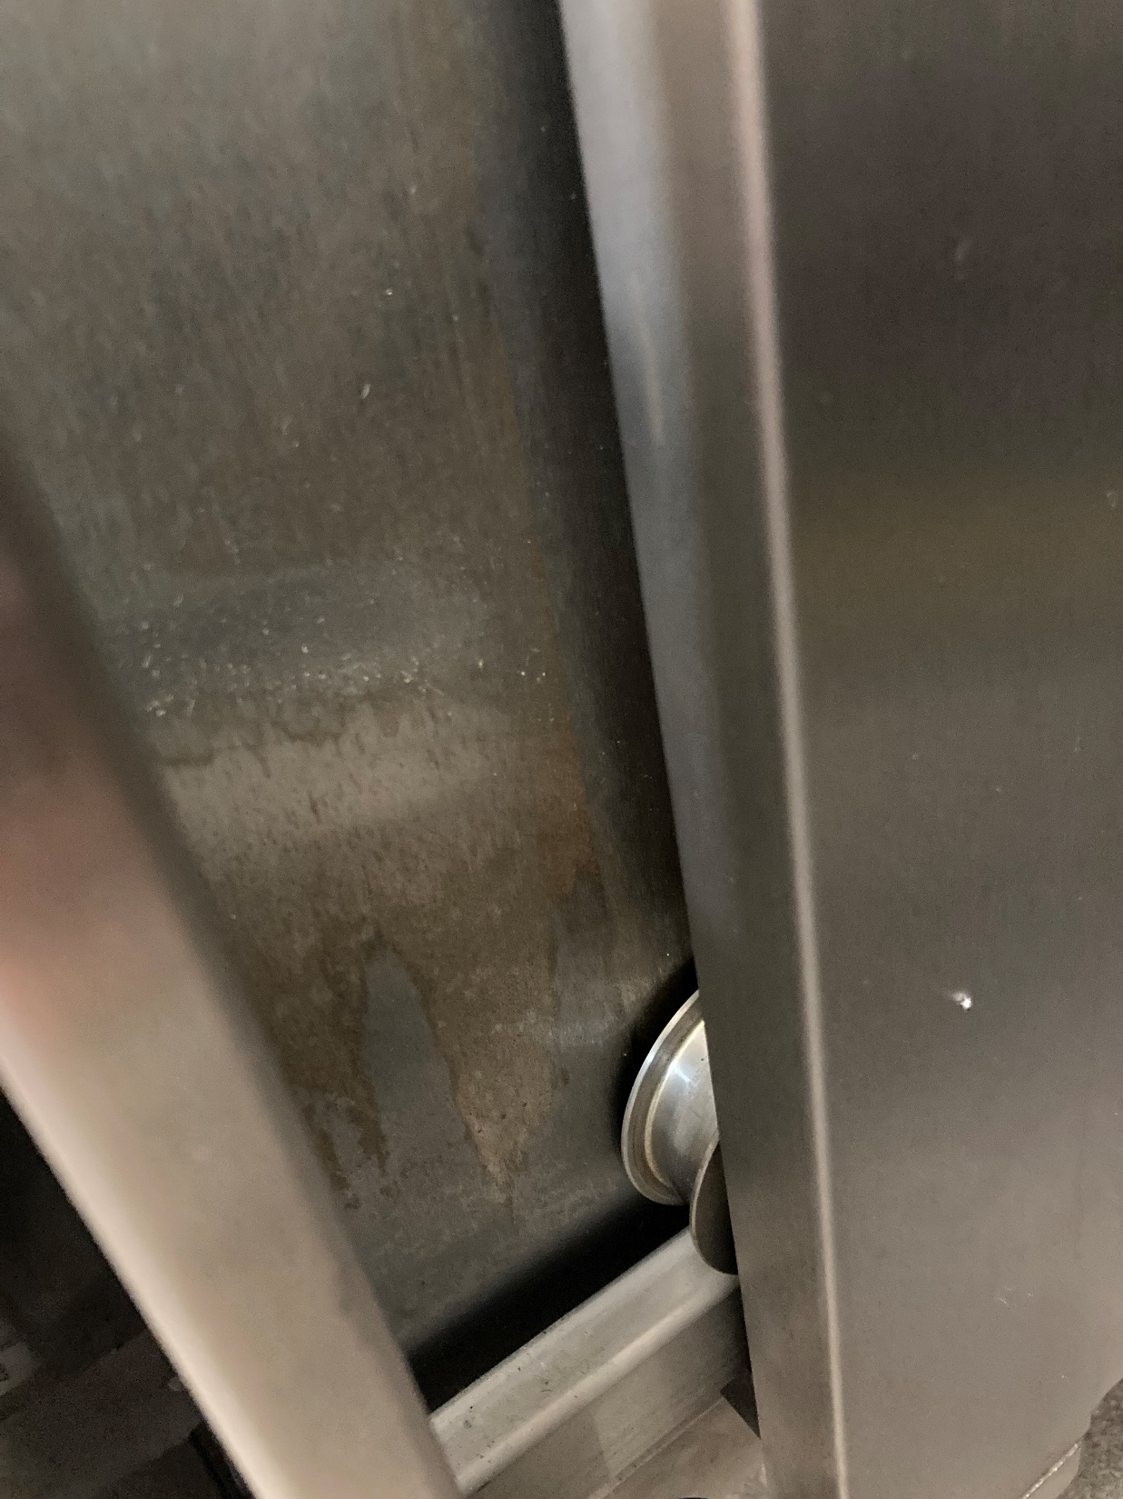
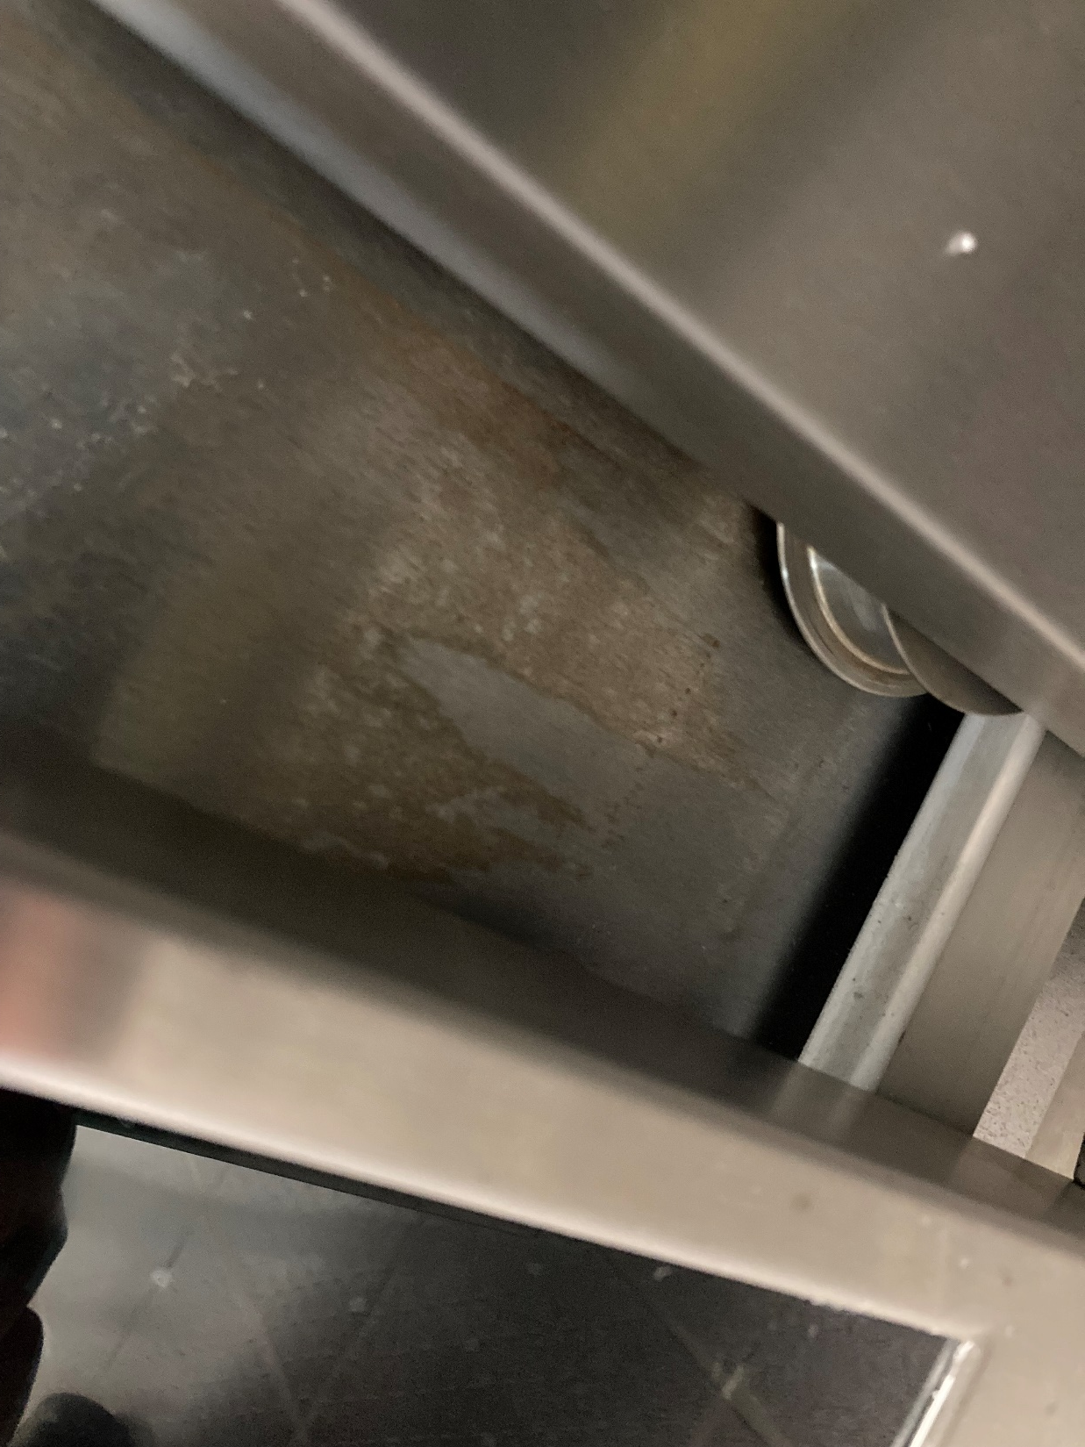
Housing behind rolling door on piece of equipment under the hood.

Slide 6
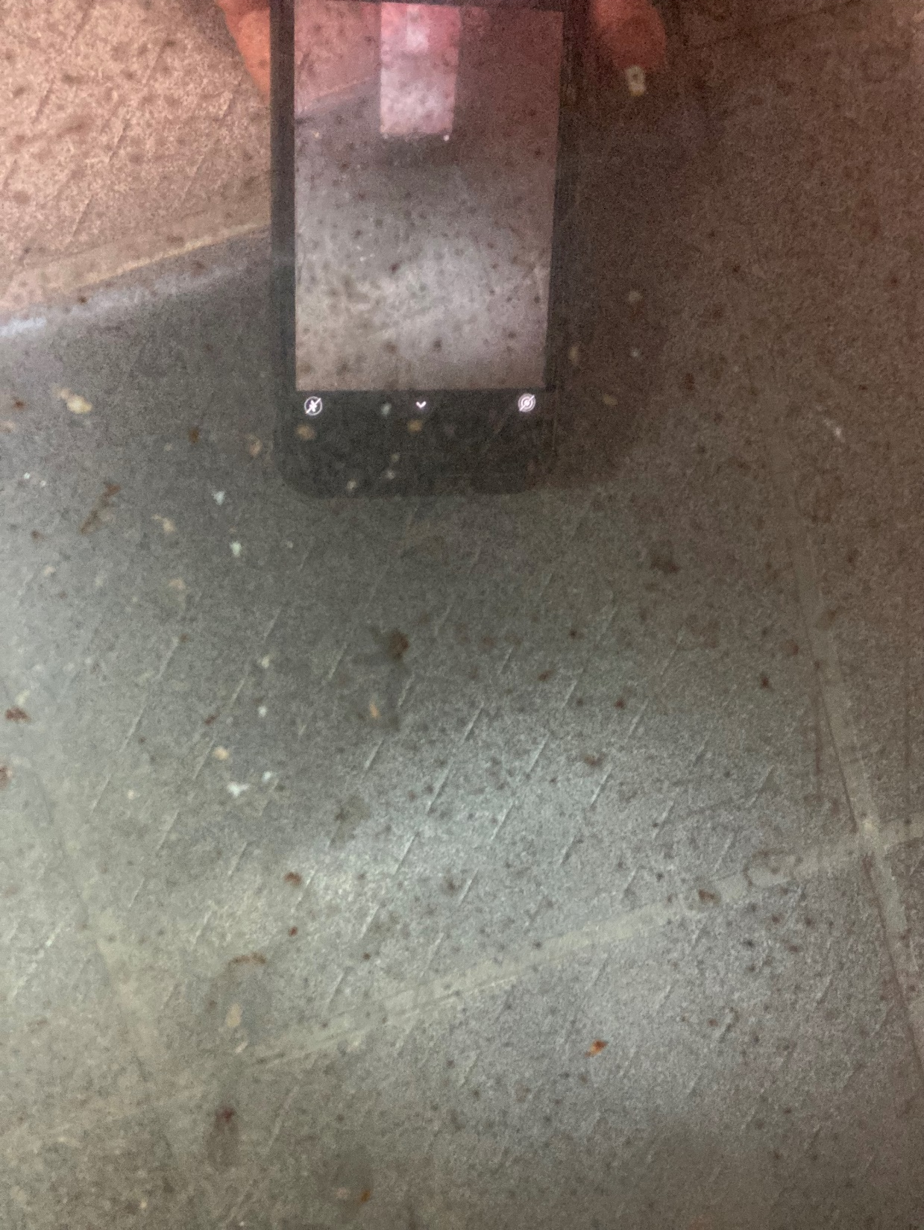
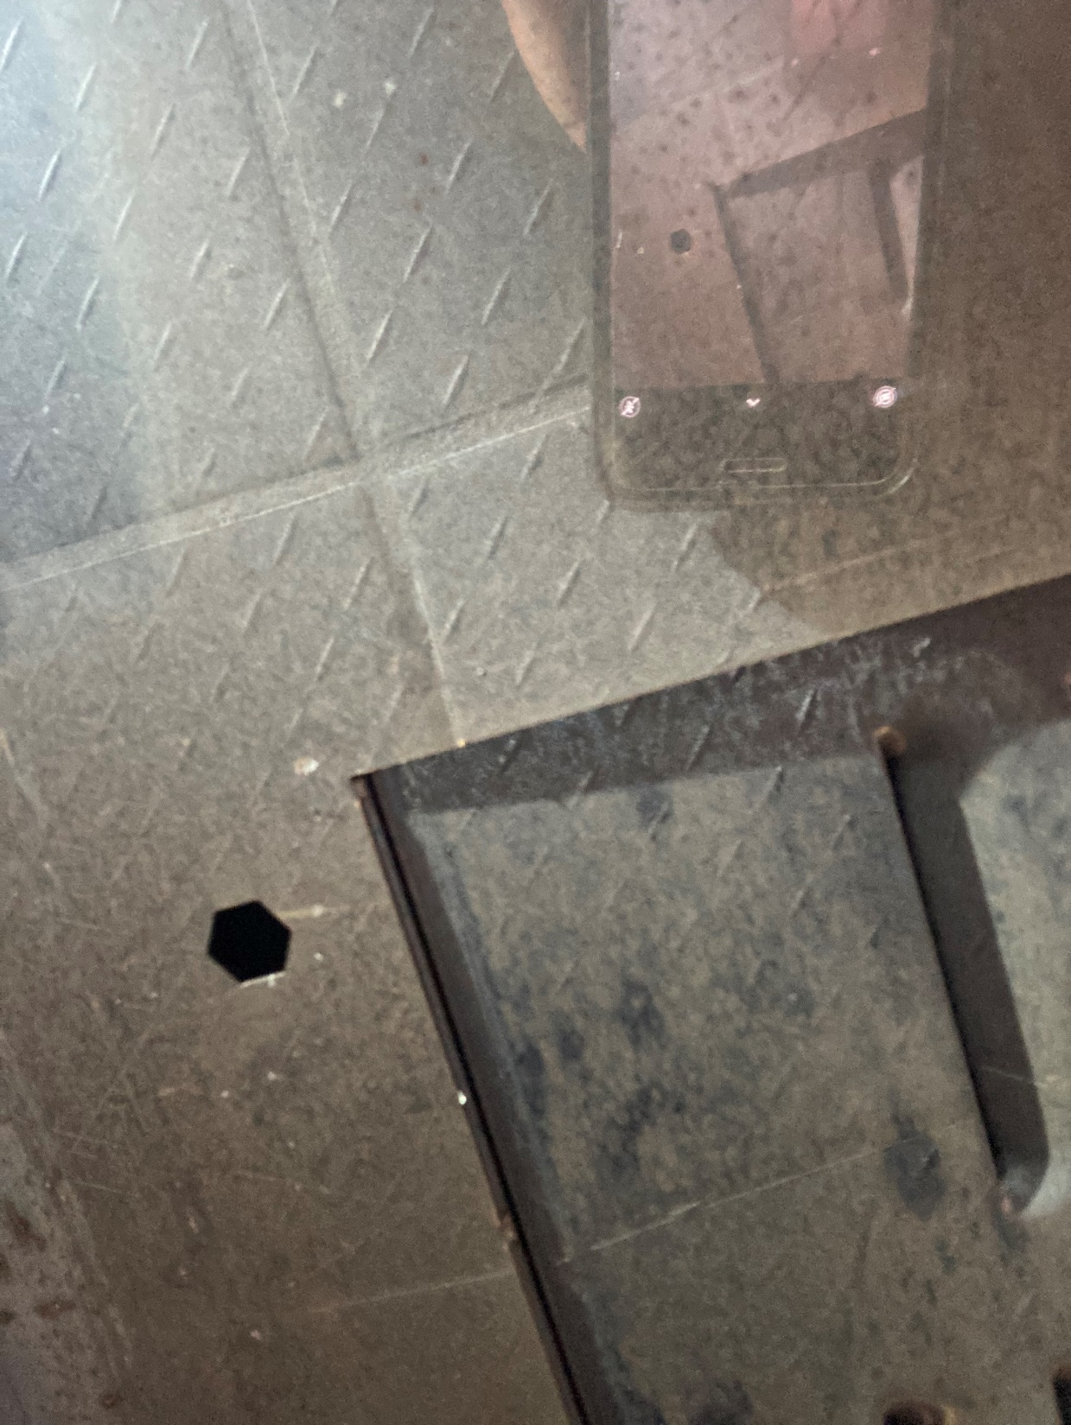
Underside of equipment under the hood.

Slide 7
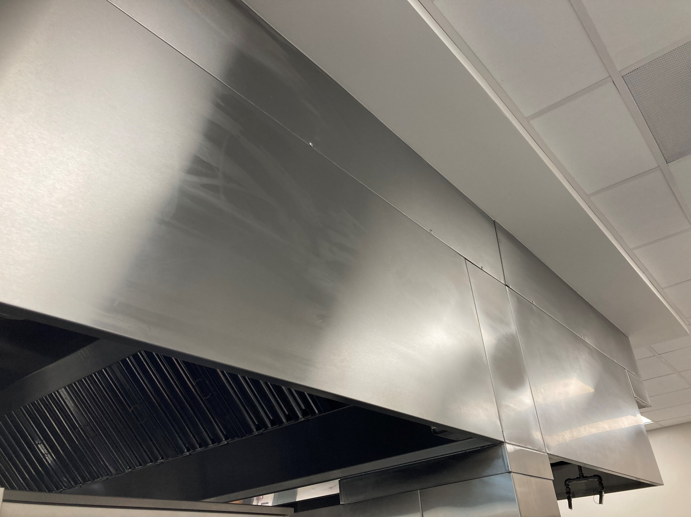
Hood

Slide 8
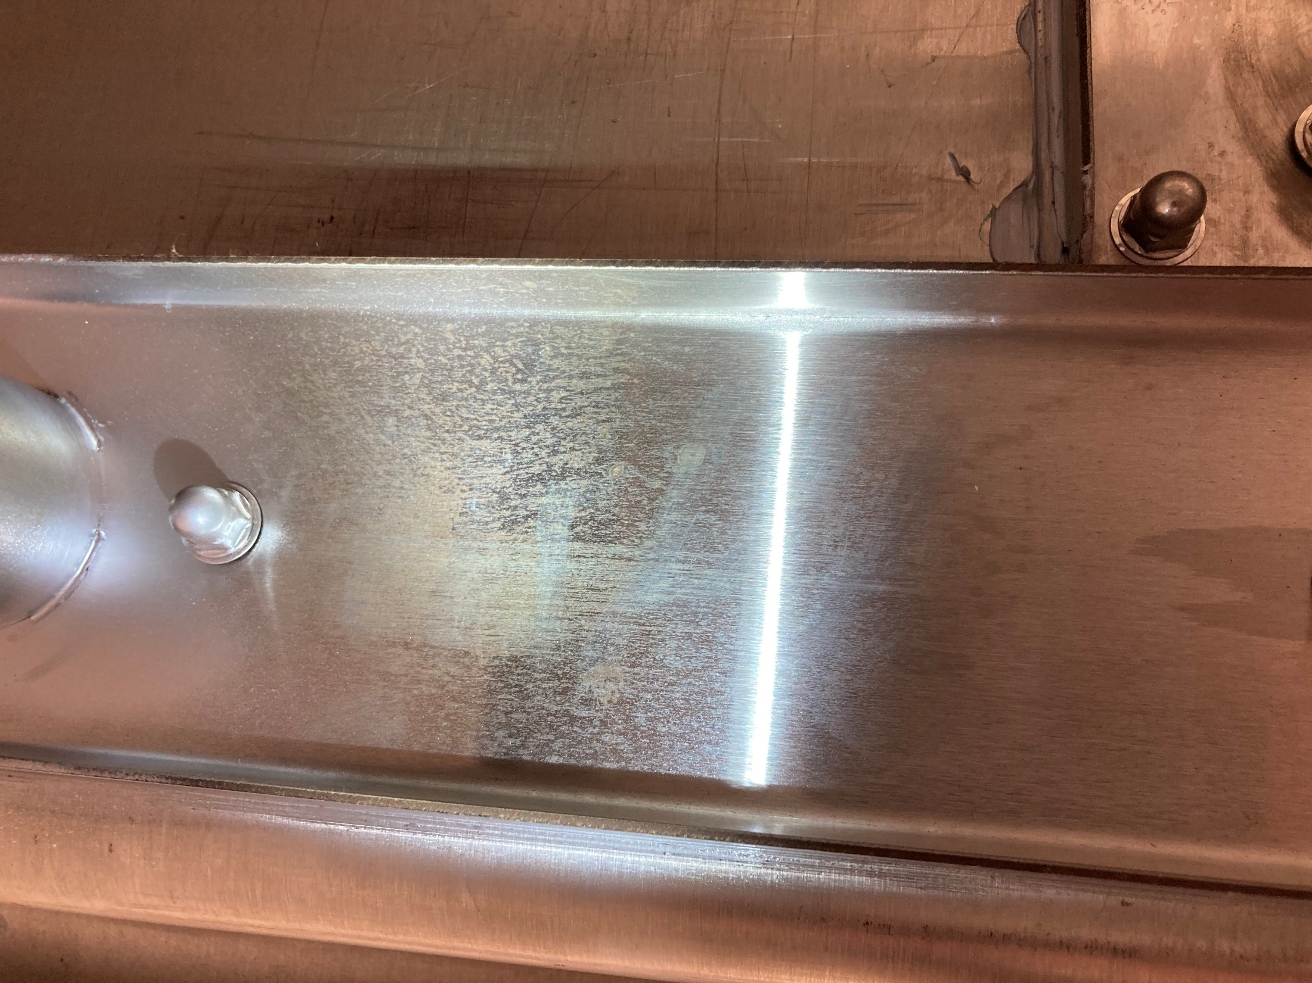
Underside of prep sink drainboard.

Slide 9
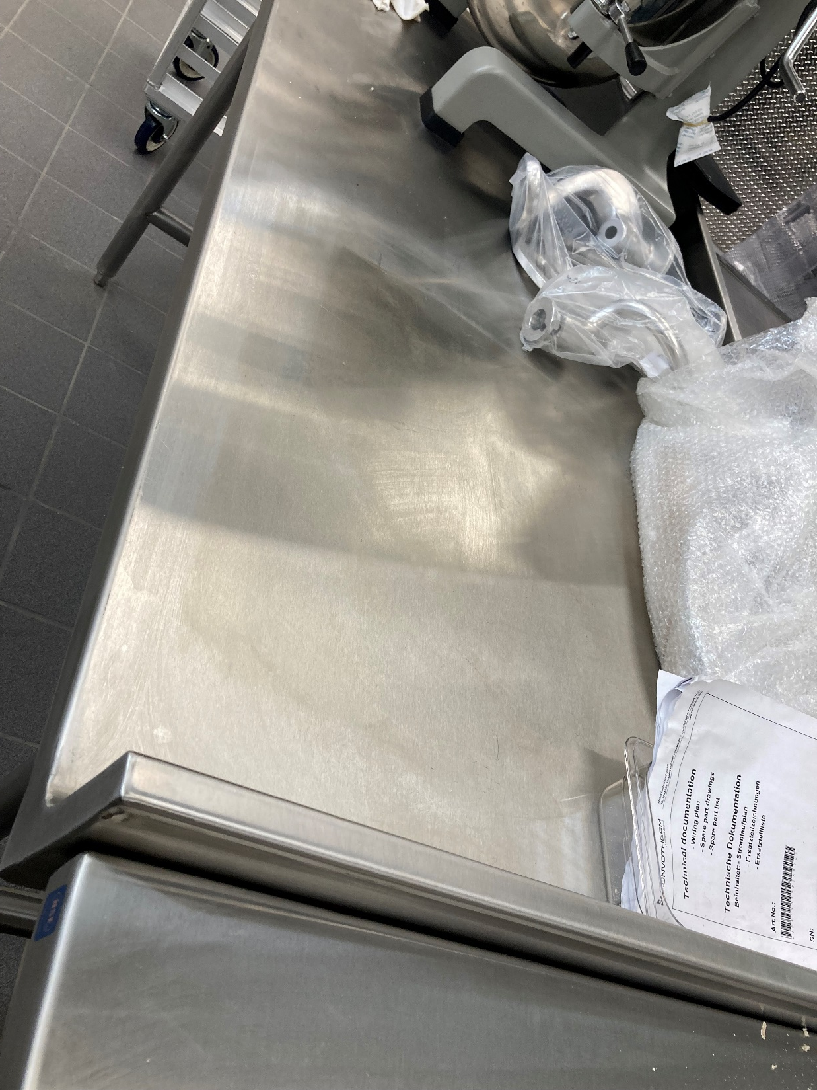
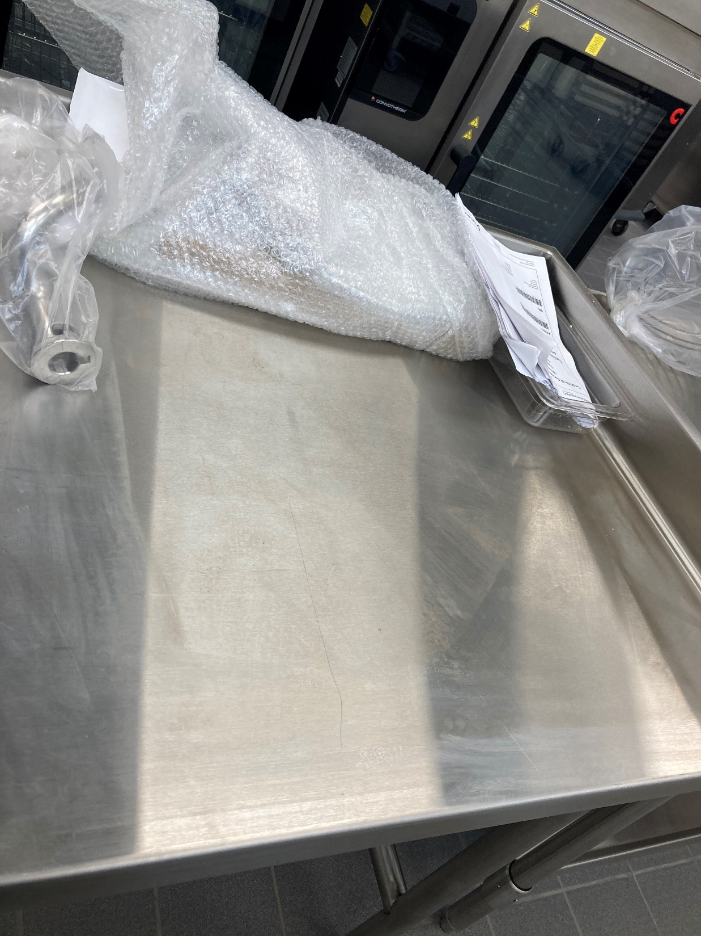
Surface of prep table. Bubble wrap had been lying on table and was pulled back just prior to photo being taken.

Slide 10
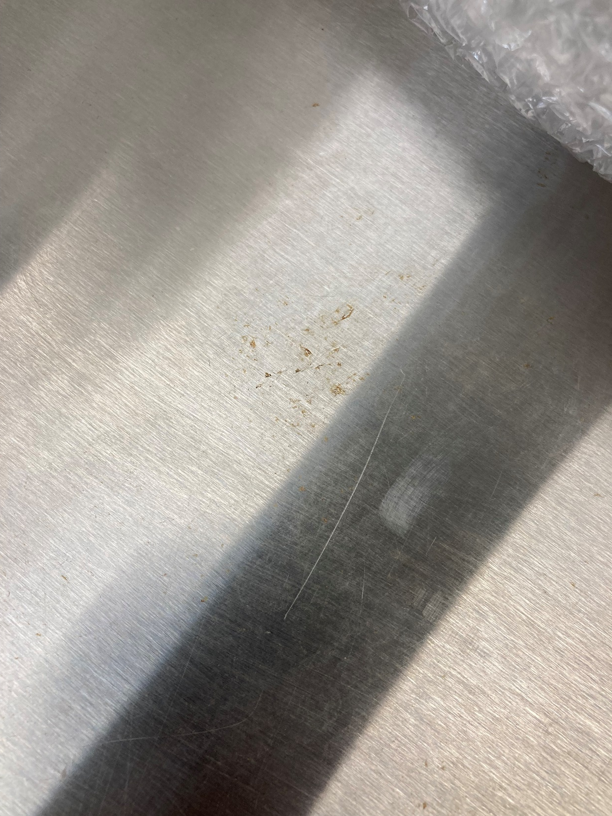
Surface of prep table

